Slide 1

Battle-Puno: 說明文件 Manual of Battle-Puno

Slide 2


Slide 3
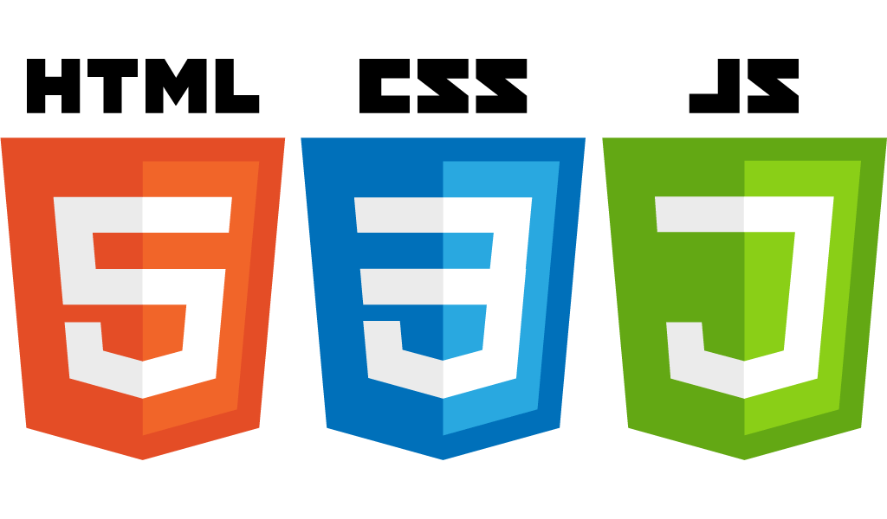


使用技術 | Library

Slide 4
架構 | Architecture
(PIXI) Application
Static Class/Module
Manager
Kernel
Instance Class
CoreClass

Slide 5
Architecture::Manager
Manager
SceneManager
DataManager
NetworkManager

Slide 6
Architecture::Kernel
Kernel
Static Class/ Module
Instance Class

Slide 7
Architecture::Kernel::Module
Name | Usage
Input | Detect keymap trigger/press/repeat
Graphics | Graphic/Image resources processing
Sound | Audio/Audio resources processing
Cache | PIXI loader resources handler

Slide 8
Architecture::Kernel::InstanceClass
Bitmap:
HTMLCanvasElement
Better utility
Challenge: DisplayOrigin

Slide 9
Architecture::CoreClass
CoreClass
Scene
Window
GameObject

Slide 10
Architecture::CoreClass(cont.)
Just too many too list here, see the source code

Slide 11
Game Play

Slide 12
Game Play::Quick Intro
Variation of original UNO game with extended rules
In current stage only supports single player
1 Player, 3 Non-Player Character
Game for killing time.
Runs on github.io, should be permanent (if no accident).
Yet another ponified game.

Slide 13
Game Play::Rules
All detail description in “rules.txt”, won’t list here.

Slide 14


分工::開發團隊 | Credits::Dev Team
Compeador(Jun-Kai Chao): >> System Kernel developing
>> User Interface >> Resources Collector
WT Cheng: Resources Handler(processing) <<
Game Rules Implement << Puno github.io webpage deployment <<

Slide 15




























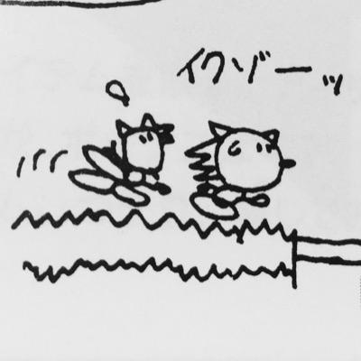




Credits::MyLittlePuno
PUNO制作委員会: Publisher of my little puno, collaborated with 32 talented artists. Link to artist’s page is given in the
hyperlink of profile icon below.

